Slide 1
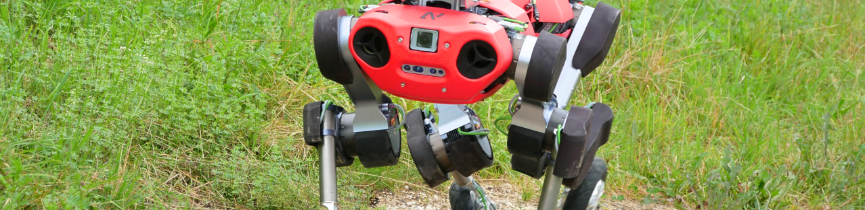
MPC-feedback Trajectory Optimization for Wheeled Robot
Chao Ni
Semester Thesis, Final Presentation
Robotic Systems Lab, ETH Zurich
30/10/2020
Supervisor: Marko Bjelonic, Ruben Grandia, Prof. Dr. Hutter
Notes:
Hello everyone, My name is Chao Ni and my semester thesis is about MPC-feedback trajectory optimization for the wheeled robot. My supervisors are Marko and Ruben.

Slide 2
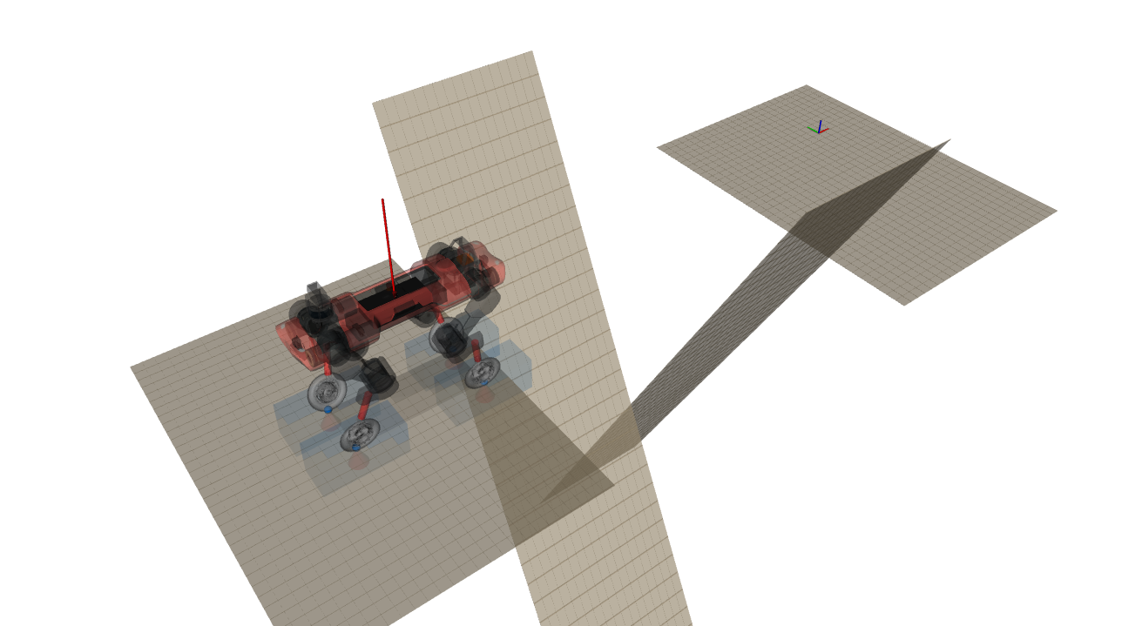
Motivation
Trajectory horizon
Prediction horizon
Notes:
We will start with why we need trajectory optimization. Imagine a robot is standing in front of a tough terrain and wants to achieve a target position. The first step for the robot is to compute how it should move towards the target feasibly and efficiently, and this involves trajectory optimization.
Second, after the robot has a trajectory in mind, it should take care of the question how to track these trajectory, and a promising approach is to use model predictive control. Due to computation issues, the horizon is relatively short compared to the whole trajectory. In our project, the trajectory can be as long as we can, and the mpc will have a horizon of one second.

Slide 3
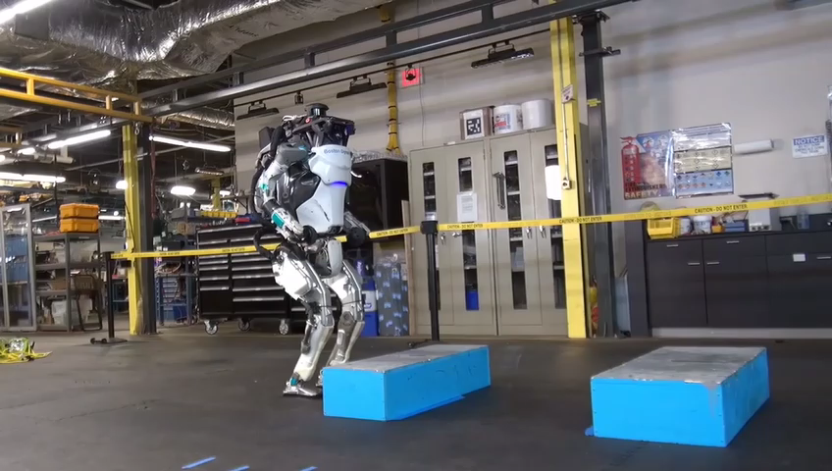
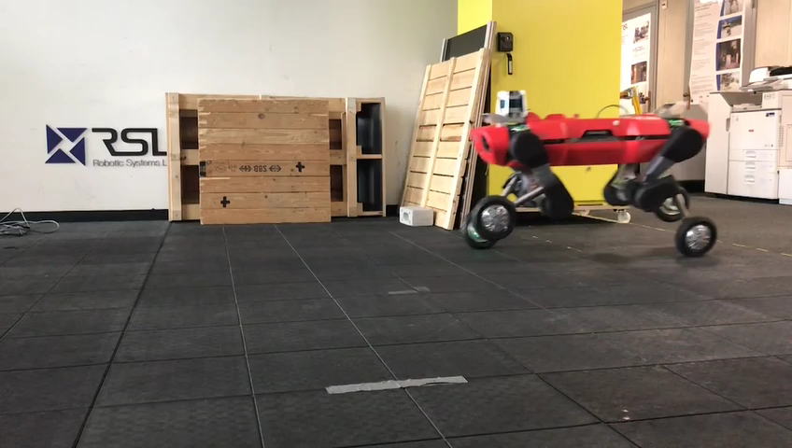
Motivation
Boston Dynamics: Atlas
Anymal Wheels: Hybrid and versatile motions/gaits.
Video sources:
1. https://www.youtube.com/watch?v=_rPvKlvyw2w&feature=emb_logo
2. https://www.youtube.com/watch?v=fRj34o4hN4I&feature=youtu.be
Notes:
Actually this approach is not new, and is already proven efficient in many applications.
For example, in Atlas from Boston Dynamics, they used the same fashion as using model predictive control to track a generated trajectory.
And in order to allow the robot to handle complicated terrains efficiently, we have this customized Anymal robot with wheels. Compared to legged robot, it is energy efficient and faster. It can perform hybrid motions and can even go hiking in the forest.
We will equip this robot with a MPC framework to conquer tough task.

Slide 4


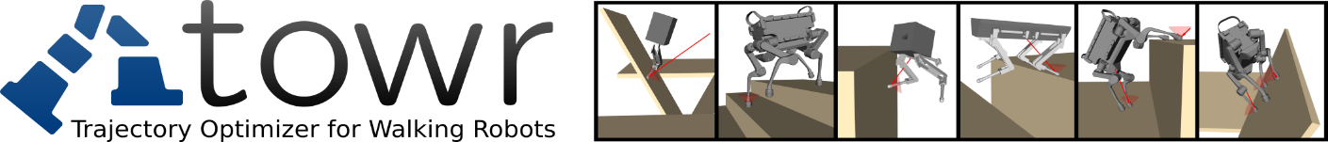

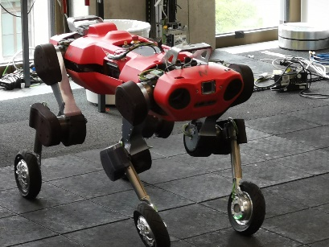
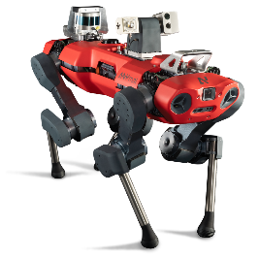



MPC-feedback Controller
Reference trajectory $q, \dot{q}$
Model predictive control:
20 Hz
Inverse kinematics
Wheel, base position, etc.
Desired control plan
Trajectory optimizer
Low level controller: 400 Hz
Smart initialization
Torque commands
Offline
Target
Online
Robot states
Notes:
Now let’s talk about how we conduct the whole process and how we implemented it.
First, a message is commanded by a human operator, we first tell the robot where do we want to go. The robot can smartly initialize its states based on the terrain information and the target position. Then the initialization state is passed through the trajectory optimizer, and we will be using towr as an optimizer in the project.
After it generates a trajectory, then we compute the reference trajectory in generalized joint space and feed this into MPC. Based on this reference as well as the measurement of the robot state, mpc controller can compute the desired control plan, which will be fed into a low-level controller, and a final torque command is given to the real robot.
The whole process on the left is offline and mpc in online.
And this trajectory optimizer can be replaced by other optimizers, for example, scp, which is already implemented by another student. Compared to scp, one of the advantage of towr is that it can compute longer trajectories.

Slide 5
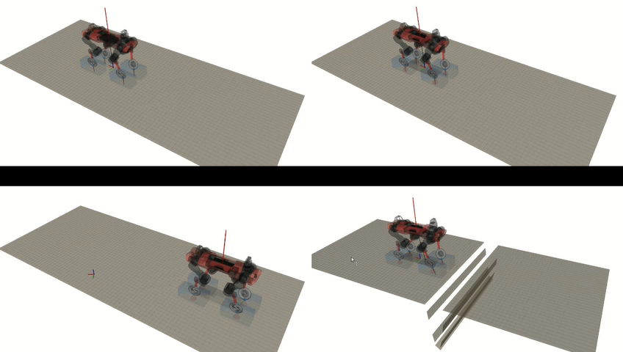
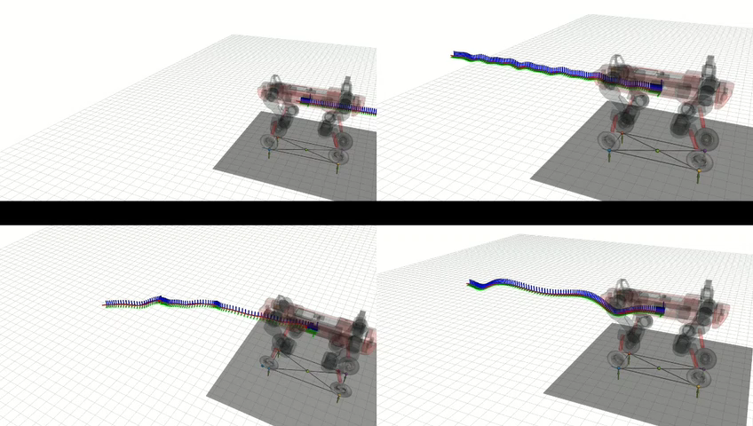
MPC Optimization Illustration
Pace forward
Rolling
Pace forward
Rolling
Overlap walk curve
Gap
Overlap walk curve
Gap
Fig.1 Desired trajectory generated by towr.
Fig. 2 MPC optimized trajectories computed on ocs2
Notes:
Here we show videos of how MPC optimization looks like.
On the left side, we have the desired trajectories which are generated by towr. We have rolling, pace forward, overlapwak curve, and gap motions. I also want to quickly mention how towr works. Basically, we generate different trajectories based on how we initialize them and end up with a feasible local optimum solution around the initialization. And we test the feasibility of the motion on a sampling basis, one way to relax the constraint is to pick less sampling points to check the feasibility, and it will speed up the computing and make online possible, we will turn to that later in the end.
On the right side, we have the optimized trajectories which are computed on ocs2. We can also seen from here that the optimization length is shorter than the desired length.

Slide 6
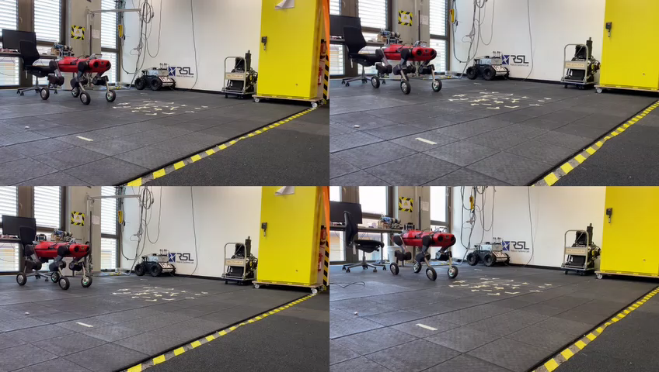
Experiment Demonstrations
Trot forward
Pace curve
Gallop forward
Gap
Notes:
We also did some experiments on the real robot.
We can see from the video that the robot can handle different tough motions, even for the pace and gallop, which is difficult generally. And it also tracks the gap motion. And when we filmed these videos, the robot mass was off the real value, but it has the robustness of handle this issue, which further shows that it’s very promising.
Although we can also find some issues in the video, for example, the robot legs sometimes don’t give enough power, but this is a hardware problem and can be easily handled. We will get back to this issue when we analyzed the data. But generally it is amazing to have this algorithm validated on the real robot.

Slide 7
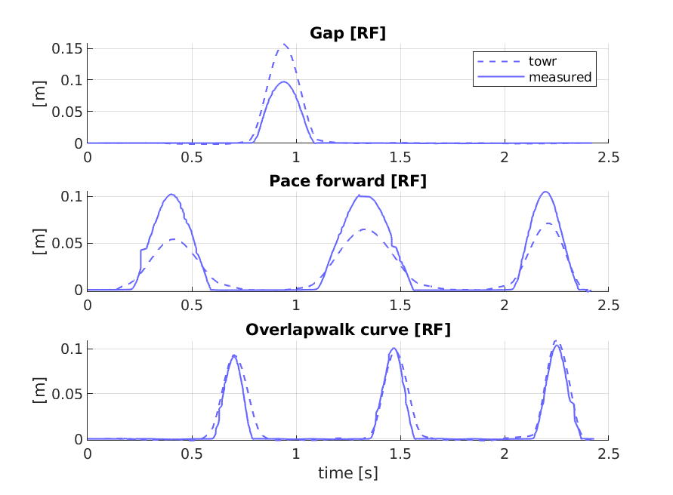
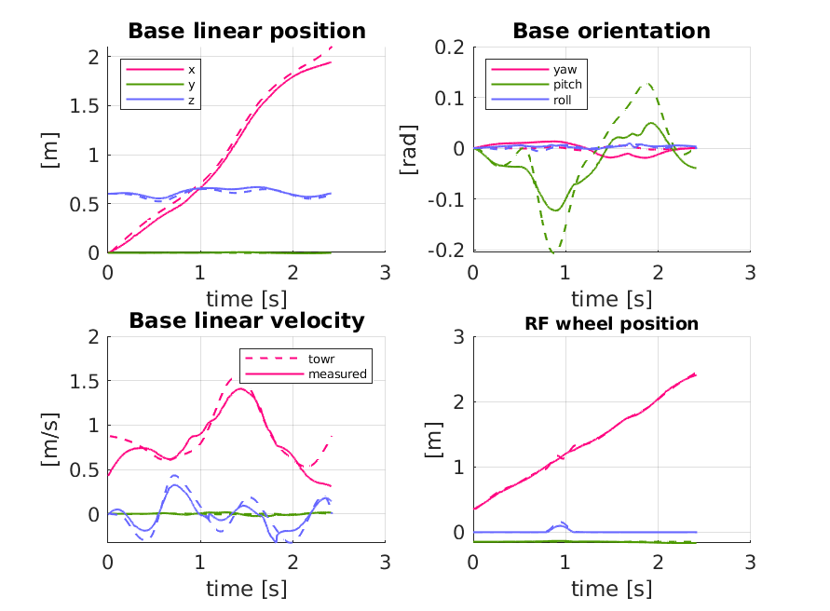
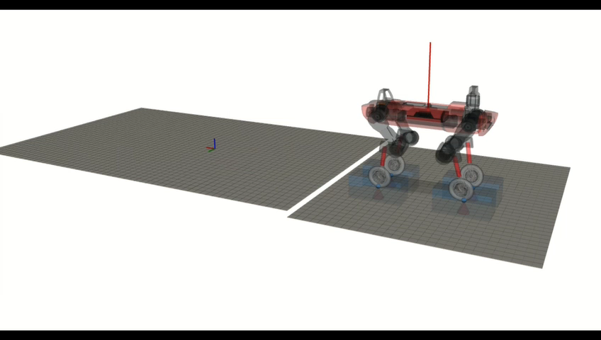
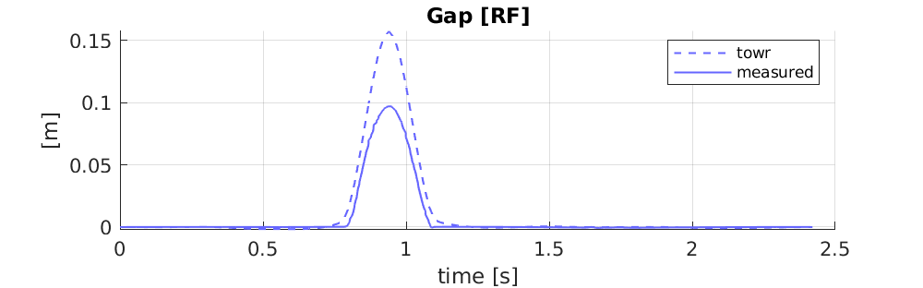
Simulation Results Gap
Fig. 7: The desired trajectory computed by towr (dashed lines) and the measured positions (full line)
Fig. 6: The desired height of RF in the gap motion (dashed line) and the measured height (full line)
Fig. 5: The desired trajectory computed by towr (dashed lines) and the measured positions (full line)
Notes:
Now let’s look at some simulation results I got. Here is the figure of comparison between measured trajectories and the desired trajectories. I analyzed the data and have some points to address.
First, if we look at the change of pitch angle, we will find that MPC imposes smoothness by adding a cost function. By doing so, it also makes the trajectory more practically feasible because some wild motions can be avoided or alleviated.
Second, if we look at this part, we will find the initial velocity of base is not zero. The most important reason is that MPC has the ability to blend between transitions. After we sent the trajectory, the robot got a feeling that a trajectory is coming and would prepare for it.
The third thing I want to address it that if we look at the swing height. We will find the measured height is not as desired due to the fact that we explicitly set the swing height in MPC. Here are some more comparison of other motions.
This is not a big issue theoretically, but we need to adjust it in the future when we want to walk over stairs. Because in that case swing height should be larger than usual depending on the height of the stair.

Slide 8
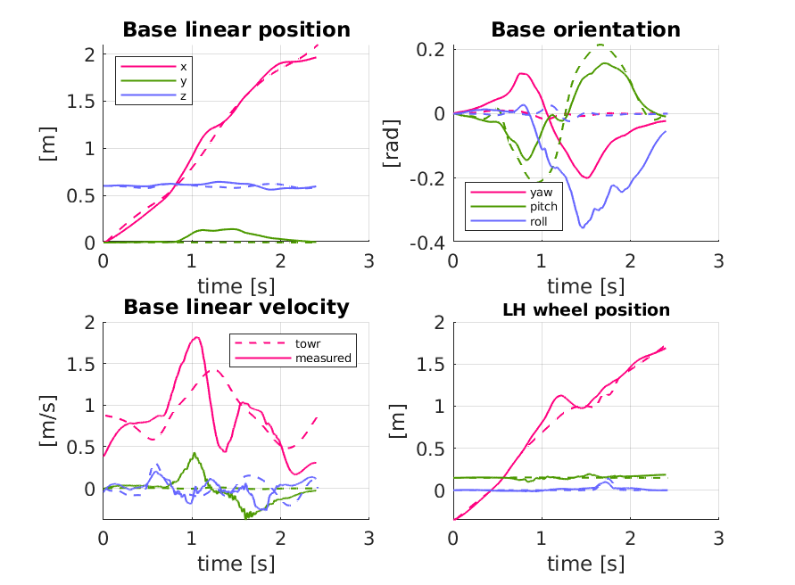
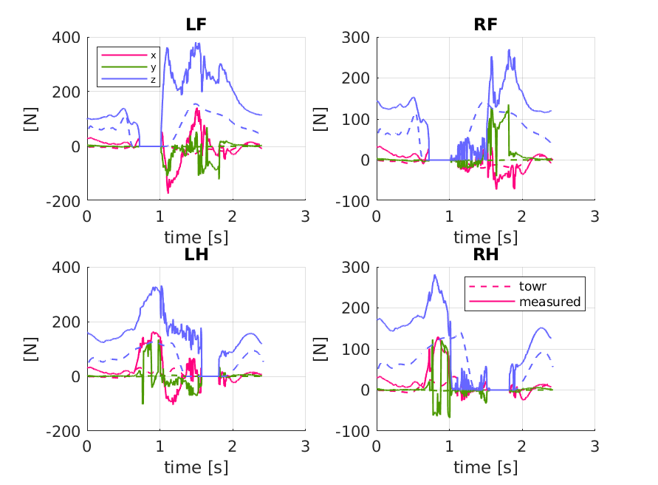
Hardware Results Gap
262N
99N
139N
153N
Fig. 8: Trajectories comparison
Fig. 9: Contact forces
Notes:
Here is the result from the real robot experiment. As we mentioned about the previous video, there is some issue about the hardware.
We will find there is a drift in y direction, which is not as expected. Also, the yaw angle and the roll angle show some strange behavior of the robot.
To analyze it, we plot the contact forces and see what is going on. I took a 0.8 second time window and computed the average contact forces during these period.
We can see when the front legs are in the air, The right hind leg has bigger contact forces, and therefore pushes the robot towards the positive y direction and when the hind legs are in the air, the left front leg has bigger power and pushed the robot back.
This also explains the behavior in yaw and roll angle.

Slide 9
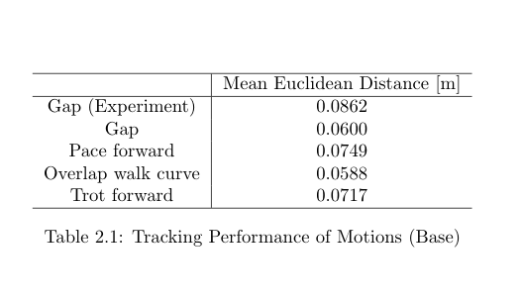
Tracking Performance
Notes:
We also try to quantify the tracking performance. I computed the average tracking error between the desired trajectory and the measured trajectory. We define the tracking error as the mean Eulidean distance over all time steps along the trajectory.
In simulation, the result is in average 6.6 centimeters tracking error

Slide 10
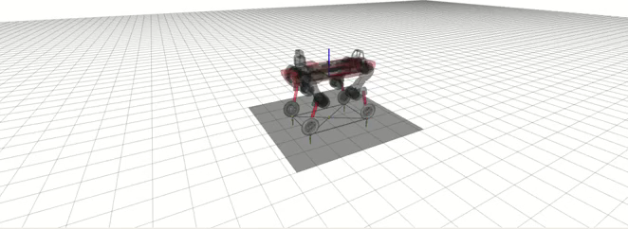
Why We Need MPC
Towr + wbc tracking error: 0.1308 m.
Towr + mpc + wbc tracking error: 0.0717 m.
Trot: towr + WBC
Notes:
We further want to know if MPC helps with tracking why mpc is so helpful.
So best way to compare is that if we skip the mpc, and use the optimized trajectory directly as a guidance and feed into low level controller. We managed that and have this video:
This is a trotting motion on simulation. we can see from the video that the motion is not smooth at all, it looks like falling anytime. In the low-level controller, it just takes care of one step ahead and will track the reference without considering its effect to the future step. However, MPC has a horizon and looks several steps ahead, there will be punishment on strange, unsmooth motions. This is the first reason why we use mpc.
Secondly, If we don’t use MPC, then we will have a higher standard for the optimized trajectory, it has to be feasible in a higher accuracy. Which means, it need more computation time. MPC however, relaxes this constraint because MPC will correct it. And this makes it possible that the whole process can be computed completely online.
And we also compared the tracking performance, for this specific case, the average tracking error is about much larger than when we have mpc.

Slide 11
Outlook
1. Explore the tough terrains.
2. Do we really need a perfectly feasible trajectory?
Towr: run the trajectory optimization a couple of iterations would already give a “close to feasible” trajectory, MPC will correct it.
Other algorithms, for example, learning based methods
Notes:
So what can we do in the future:
First we should continue on our track and explore more tough terrains.
Secondly, i also want to raise the question here: do we really need a perfectly feasible trajectory?
becasue for towr, if the initialization is good enough, we can just run the trajectory optimization for a a couple iterations and the resulting trajectory is already good enough to track, it may not be feasible yet, but MPC will correct it.
Second, if we don’t need perfectly feasible trajectories, there are other ways to explore it. For example, learning based method, we can build a neural network and train it for a short time, and early stopping when the solution is reasonable, and let MPC to finish the rest part.

Slide 12
Q&A

Slide 14
Reference trajectory $q, \dot{q}$
Model predictive control:
20 Hz
Inverse kinematics
Wheel, base position, etc.
Desired control plan
Trajectory optimizer
Low level controller: 400 Hz
Smart initialization
Torque commands
Offline
Target
Online
Robot states
Notes:
Now let’s talk about how we conduct the whole process and how we implemented it.
First, a message is commanded by a human operator, we first tell the robot where do we want to go. The robot can smartly initialize its states based on the terrain information and the target position. Then the initialization state is passed through the trajectory optimizer, and we will be using towr as an optimizer in the project.
After it generates a trajectory, then we compute the reference trajectory in generalized joint space and feed this into MPC. Based on this reference as well as the measurement of the robot state, mpc controller can compute the desired control plan, which will be fed into a low-level controller, and a final torque command is given to the real robot.
The whole process on the left is offline and mpc in online.
And this trajectory optimizer can be replaced by other optimizers, for example, scp, which is already implemented by another student. Compared to scp, one of the advantage of towr is that it can compute longer trajectories.

